Slide 1
Secure RPC File System in C
Made By :
Sayan Sarkar ( 2k17/CO/315 )
Vinayak Chaudhary ( 2k17/CO/374 )

Slide 2
Objectives :
To create a secure distributive file system using RPCs between clients and server.
File System should implement common unix commands such as pwd, ls, cp, cat, write, find & rm.
Good authentication between clients and server.

Slide 3
About RPC
Remote Procedure Call (RPC) is a protocol that one program can use to request a service from a program located in another computer on a network without having to understand the network's details. RPC is used to call other processes on the remote systems like a local system. A procedure call is also sometimes known as a function call or a subroutine call.

Slide 4
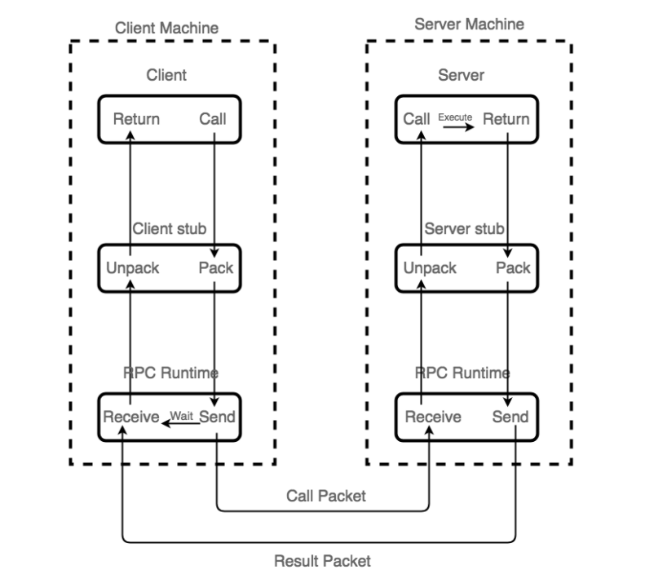
Working of RPCs :

Slide 5
About rpcgen!
rpcgen is a tool that generates C code to implement an RPC protocol. The input to rpcgen is a language similar to C known as RPC Language (Remote Procedure Call Language).
rpcgen is normally used as in the first synopsis where it takes an input file and generates up to four output files. If the infile is named dis.x, then rpcgen will generate a header file in dis.h, XDR routines in dis_xdr.c, server-side stubs in dis_svc.c, and client-side stubs in dis_clnt.c.
This client code would be created in dis_client.c.
This server code would be created in dis_server.c.
External data representation (XDR) standard -Data for RPCs are transmitted using this standard. XDR library routines should be used to transmit data accessed (read or written) .
XDR works across different languages, operating systems, and machine architectures.
Command to install rpcgen -> sudo apt-get install rpcbind / brew install rpcbind.
Command to configure RPC and get files -> rpcgen –a –C dis.x.

Slide 6
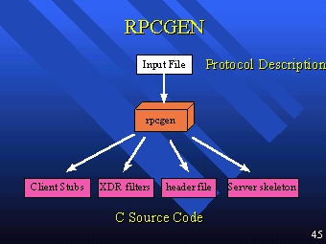
Rpcgen

Slide 7
Main Project Contents :
dis_client.c – code for client .
dis_server.c – code for server .
dis.h - compilation header file for all necessary globals and header files.
makefile – a make file to compile all the files after changes using command ”make”.

Slide 8
Necessary Commands to run system :
Server ---→ Client
make ( to compile all files at a go )
sudo ./server ( command to run server )
sudo ./client [host] operation [filename] [string | length] ( command to run client )→ Eg: sudo ./client localhost ls

Slide 9
About Authentication :
AUTH_KERB is conceptually similar to AUTH_DES. The essential difference is that DES passes a network name and a DES-encrypted session key, while Kerberos passes the encrypted service ticket.
Kerberos uses the concept of a time window in which its credentials are valid. It does not place restrictions on the clocks of the client or server.
Example of authentication failure due to invalid host,

Slide 10
About Authentication :
Another authentication method used in this project was generating a random 12 bit key viz. exchanged between client and server every time a new client request is being made which ensures secure response to the RPC calls by client.
This 12 bit key contains letters A-Z, a-z, and numbers 0-9 as the domain.

Slide 11

Demo Outputs for File System :
“pwd” command : The pwd ( present working directory ) command is a command line utility for printing the current working directory.
It will print the full system path of the current working directory to standard output

Slide 12
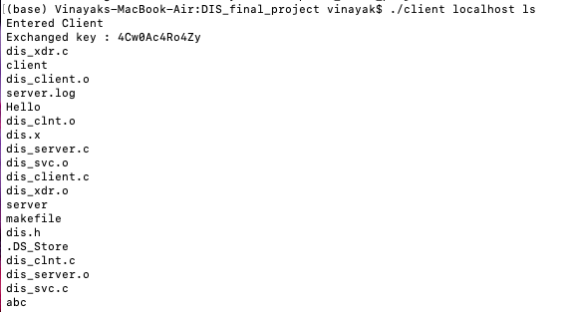
Demo Outputs for File System :
“ls” command : The ls command is a command-line utility for listing the contents of a directory or directories given to it via standard input

Slide 13
Demo Outputs for File System :
“cp” command : cp stands for copy. This command is used to copy files or group of files or directory. It creates an exact image of a file on a disk with different file name. cp command require at least two filenames in its arguments. Contents of abc.txt are being copied to a.txt.

Slide 14

Demo Outputs for File System :
“write” command : write command is used to write lines to any file name provided. “Hello World” is being
written in file abc.
“cat” command : cat is a standard Unix utility that reads files sequentially, writing them to standard output.
First 11 bytes are being read of file abc.

Slide 15

Demo Outputs for File System :
“rm” command : rm command is used to remove objects such as files, directories, symbolic links and so on from the file system like UNIX
“find” command : The find command in UNIX is a command line utility for walking a file hierarchy. It can be used to find files and directories and perform subsequent operations on them

Slide 16
THANKS

